Slide 1
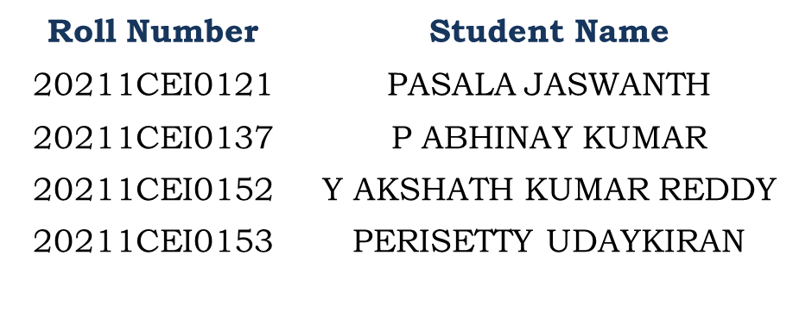
Patient-Case-Similarity(Skin Smart)
PIP104 University Project-II
Review-2
Batch Number:
Under the Supervision of,
Dr. P Sudha
Assistant Professor
School of Computer Science & Engineering
Presidency University

Slide 2
ABSTRACT
This project entails the development of a mobile application for skin disease detection and management, utilizing Android XML for frontend design and Kotlin for backend functionality. The application is structured to serve three primary user roles: Admin, Hospitals, and Users, each with distinct capabilities. For the Admin, the application provides secure login, functionalities to add and manage hospital details, and view registered users, ensuring efficient oversight and administration of the system. Hospitals can log in to their dedicated interface to view patient appointments, facilitating streamlined appointment management and patient care. Users, the core beneficiaries, can log in to access various features aimed at improving skin health management. The application enables users to scan and detect skin diseases using advanced image recognition technology. Additionally, users can view nearby hospitals, add appointments with dermatologists, and maintain a history of their medical consultations and treatments. This feature-rich application ensures a seamless and integrated experience for managing skin health, from initial diagnosis to ongoing care. Overall, this mobile application aims to provide a comprehensive solution for skin disease management, leveraging the robustness of Kotlin for backend processes and the flexibility of Android XML for an intuitive user interface.
KEYWORDS: Mobile application, Android.

Slide 3
OBJECTIVE OF PROJECT
The objective of this project is to develop a mobile application using Android XML and Kotlin for efficient management of skin diseases. The application aims to provide early detection through image recognition, streamline appointment scheduling, and facilitate easy access to specialized healthcare services. By enhancing user experience with a user-friendly interface and robust backend functionality, the project seeks to improve overall healthcare delivery and patient outcomes in the management of skin conditions.

Slide 4
PROBLEM STATEMENT
The current managing skin diseases is inefficient, relying on manual processes for diagnosis and appointment scheduling, leading to delays in treatment. The lack of centralized digital records complicates patient history tracking, while finding nearby specialized hospitals remains cumbersome. These limitations hinder timely and effective care, necessitating an integrated, user-friendly solution to streamline skin disease detection, management, and access to healthcare services

Slide 5
SCOPE
The scope of this project includes developing a mobile application for comprehensive skin disease management using Android XML and Kotlin. The application will feature secure login for Admins, Hospitals, and Users, enabling functionalities such as skin disease detection, hospital management, appointment scheduling, and patient history tracking. By integrating advanced image recognition technology and providing a user-friendly interface, the project aims to streamline healthcare processes and improve accessibility to specialized skin disease treatment.

Slide 6
MOTIVATION
The motivation behind this project is to leverage mobile technology and AI to enhance dermatology care. Skin diseases affect millions globally, necessitating accessible and efficient management tools. By providing advanced image recognition for disease detection, streamlined appointment management, and comprehensive care features, this application aims to bridge the gap between patients and healthcare providers, improving overall skin health outcomes.

Slide 7
INTRODUCTION
In recent years, advancements in mobile technology and artificial intelligence have significantly transformed the healthcare industry. The development of mobile applications for health management has enabled individuals to access healthcare services more efficiently and conveniently. One such critical area of health that can benefit from technological innovation is dermatology. Skin diseases affect millions of people worldwide, necessitating a reliable, accessible, and efficient method for detection and management. This project aims to address this need by developing a comprehensive mobile application for skin disease detection and management, utilizing the Android platform with Kotlin for backend functionality and Android XML for frontend design. The application is designed to cater to three primary user roles: Admin, Hospitals, and Users. Each role is equipped with distinct capabilities to enhance the overall functionality and user experience of the system. Admins are provided with a secure login interface and functionalities to add and manage hospital details and view registered users.

Slide 8
Conti..
Users, the core beneficiaries of the application, can log in to access features aimed at improving skin health management. For users, the application offers advanced image recognition technology to scan and detect skin diseases. This feature empowers users with the ability to perform initial diagnostics from the comfort of their homes. Additionally, users can view nearby hospitals, add appointments with dermatologists, and maintain a history of their medical consultations and treatments. This comprehensive suite of features ensures that users receive continuous and integrated care for their skin health. The integration of advanced image recognition technology for disease detection, coupled with functionalities for appointment management and medical history maintenance, positions this application as a revolutionary tool in dermatology care. The use of Kotlin for backend processes ensures robust performance, while Android XML provides a flexible and intuitive user interface. Overall, this mobile application aims to bridge the gap between patients and healthcare providers, offering a seamless and integrated experience for managing skin health, from initial diagnosis to ongoing care.

Slide 9
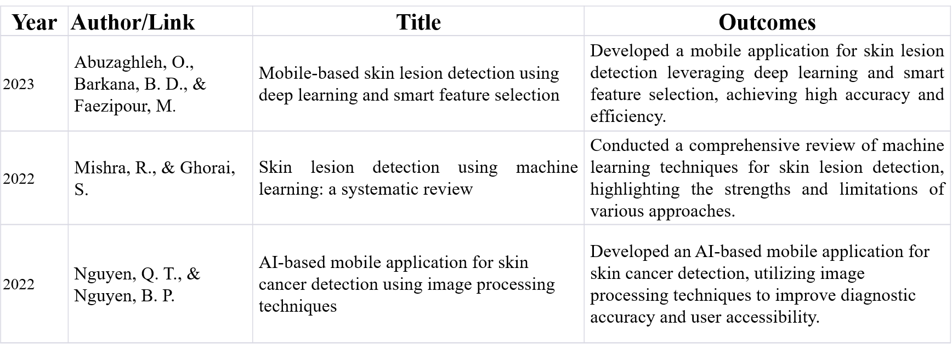
Literature Review

Slide 10
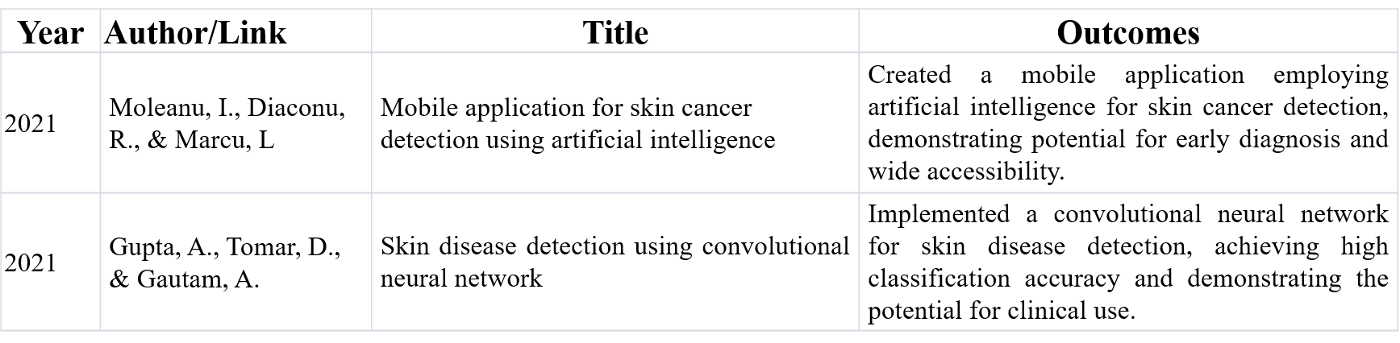
Conti..

Slide 11
EXISTING SYSTEM
Current systems for skin disease management typically involve manual processes, where patients must visit dermatologists for diagnosis and treatment. There is limited use of technology for early detection and management, leading to delayed treatments. Appointment scheduling and patient history tracking are often inefficient, relying on paper records or basic digital systems. Additionally, finding nearby specialized hospitals can be cumbersome, lacking integration and user-friendly interfaces for comprehensive care.

Slide 12
DISADVANTAGES
Reliance on manual diagnosis and treatment scheduling leads to delays and inefficiencies in patient care.
Lack of centralized digital records makes tracking patient history and managing appointments cumbersome.
Difficulty in finding nearby specialized hospitals and lack of integrated, user-friendly interfaces hinder timely and effective treatment.

Slide 13
Proposed Method
The proposed system is a mobile application designed for comprehensive skin disease management. Built with Android XML for the frontend and Kotlin for the backend, it caters to three user roles: Admin, Hospitals, and Users. Admins can log in, add hospitals, and view users. Hospitals can log in to view patient appointments. Users can log in to scan for skin diseases using image recognition technology, view nearby hospitals, schedule appointments, and maintain a history of their consultations. This system aims to streamline skin disease detection and treatment, providing an integrated and user-friendly platform for all stakeholders. Here we are using the Mobile net algorithm. These model is used for the image processing to detected the image.

Slide 14
ADVANTAGES
Android XML ensures an intuitive and accessible frontend for all users.
Users can easily find nearby hospitals, schedule appointments, and maintain a detailed history of their treatments.
Kotlin backend provides robust performance and smooth integration of features, ensuring a reliable application experience.

Slide 15
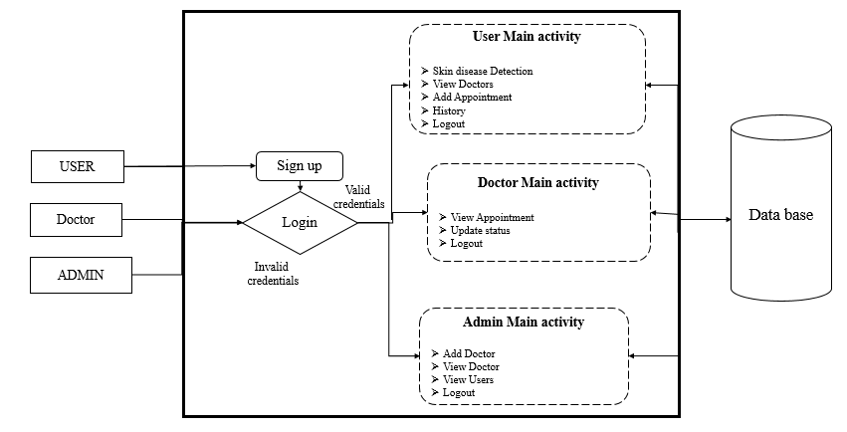
PROJECT WORKFLOW

Slide 16
Modules
USERS: Users can register, login, scan skin diseases using image recognition, view nearby hospitals, add appointments, and maintain a medical history all through a user-friendly mobile application.
ADMIN: Admins can securely login, add new hospitals to the system, and view registered users' details using the mobile application interface.
HOSPITAL: Hospitals can log in securely and access their dedicated interface to view scheduled appointments made by users through the mobile application.

Slide 17
Objectives
Develop an intuitive mobile application using Android XML and Kotlin for efficient skin disease detection and management.
Implement advanced image recognition technology for early and accurate diagnosis of skin diseases.
Enable secure multi-role access for administrators, hospitals, and users.Streamline appointment scheduling and patient history tracking.
Enhance accessibility to specialized healthcare services and improve overall patient outcomes.

Slide 18
Methodology
Requirement Analysis: Define the functional and non-functional requirements based on user needs and existing gaps in dermatology care.
System Design: Create architecture diagrams, UML models, and workflow systems tailored to the application's multi-user capabilities.
Development:
Frontend: Utilize Android XML for a user-friendly interface.
Backend: Leverage Kotlin to ensure robust application performance and seamless integration of features.
Algorithm Implementation: Integrate the Mobile Net algorithm for image recognition and processing to enable skin disease detection.
Database Integration: Use MySQL to manage user data, appointments, and hospital records efficiently.
Testing and Validation: Conduct extensive testing to ensure functionality, accuracy, and performance across all user roles and scenarios.
Deployment and Maintenance: Launch the application and provide regular updates to incorporate user feedback and technological advancements.

Slide 19
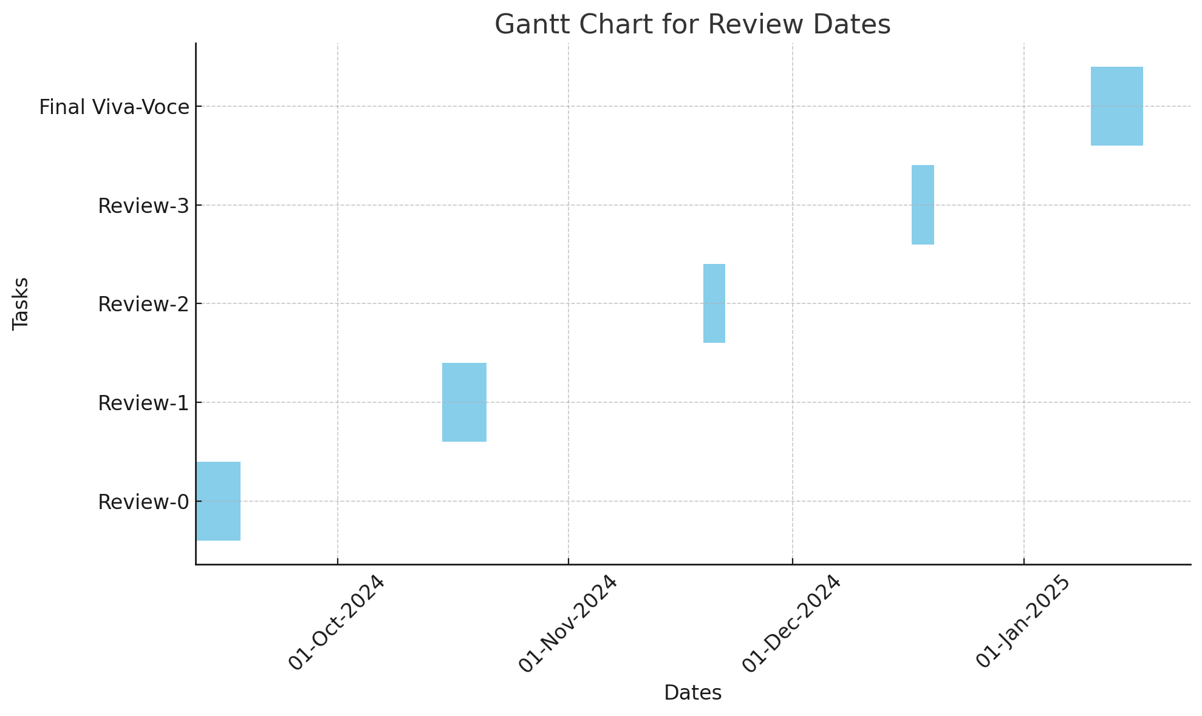
Timeline of Project

Slide 20
Expected Outcomes
Early Detection: Facilitate prompt identification of skin diseases using advanced image recognition technology.
Improved Accessibility: Ensure easier access to dermatology care by integrating functionalities like nearby hospital location and appointment scheduling.
Enhanced Patient Care: Provide users with tools to maintain a detailed medical history, aiding continuous and integrated care.
Streamlined Processes: Offer a centralized platform for users, hospitals, and administrators, reducing inefficiencies in diagnosis and treatment management.
Better Healthcare Delivery: Improve the overall dermatology care ecosystem through a cohesive and technologically advanced application.

Slide 21
Conclusion
The SkinSmart mobile application represents a significant step forward in dermatology care by leveraging cutting-edge technology for efficient skin disease detection and management. By integrating advanced image recognition, user-friendly interfaces, and robust backend functionality, the application effectively bridges the gap between patients and healthcare providers. This innovation not only streamlines the diagnostic and treatment processes but also ensures improved healthcare delivery and patient outcomes. With its comprehensive suite of features, SkinSmart has the potential to revolutionize dermatology care, providing users with accessible, timely, and effective solutions for skin health management.

Slide 22
References
Abuzaghleh, O., Barkana, B. D., & Faezipour, M. (2023). Mobile-based skin lesion detection using deep learning and smart feature selection. In 2023 IEEE 20th International Symposium on Biomedical Imaging (ISBI) (pp. 1-4). IEEE.
Mishra, R., & Ghorai, S. (2022). Skin lesion detection using machine learning: a systematic review. Journal of Ambient Intelligence and Humanized Computing, 13(2), 1021-1034.
Nguyen, Q. T., & Nguyen, B. P. (2022). AI-based mobile application for skin cancer detection using image processing techniques. Journal of Medical Imaging and Health Informatics, 12(2), 345-352.
Moleanu, I., Diaconu, R., & Marcu, L. (2021). Mobile application for skin cancer detection using artificial intelligence. In 2021 International Conference on e-Health and Bioengineering (EHB) (pp. 1-4). IEEE.
Gupta, A., Tomar, D., & Gautam, A. (2021). Skin disease detection using convolutional neural network. Procedia Computer Science, 167, 2419-2428.

Slide 23
References
Han, S. S., Kim, M. S., Lim, W., Park, G. H., Park, I., & Chang, S. E. (2020). Classification of the clinical images for benign and malignant cutaneous tumors using a deep learning algorithm. Journal of Investigative Dermatology, 140(7), 1538-1546.
Tschandl, P., Rinner, C., Apalla, Z., Argenziano, G., Codella, N., Halpern, A., & Kittler, H. (2020). Human–computer collaboration for skin cancer recognition. Nature Medicine, 26(8), 1229-1234.
Liu, Y., Jain, A., Eng, C., Way, D. H., Lee, K., Bui, P., & Coz, D. (2020). A deep learning system for differential diagnosis of skin diseases. Nature Medicine, 26(6), 900-908.
Esteva, A., Kuprel, B., Novoa, R. A., Ko, J., Swetter, S. M., Blau, H. M., & Thrun, S. (2017). Dermatologist-level classification of skin cancer with deep neural networks. Nature, 542(7639), 115-118.
Brinker, T. J., Hekler, A., Enk, A. H., Berking, C., Haferkamp, S., Hauschild, A., ... & von Kalle, C. (2019). Deep neural networks are superior to dermatologists in melanoma image classification. European Journal of Cancer, 119, 11-17.

Slide 24
Thank You

